Slide 1
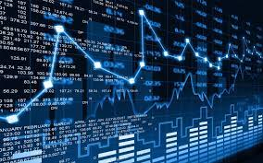

Stock Price Prediction Machine Learning
Misk Skills – DSI
Ismail Sadiq
Notes:
© Copyright PresentationGO.com – The free PowerPoint and Google Slides template library

Slide 2

Objectives
Why Stock Price Prediction?
Data Science Methodology
Stock Price Prediction Machine Learning Tools
Linear Regression
AutoTS Package
Facebook prophet model
Conclusion
Notes:
© Copyright PresentationGO.com – The free PowerPoint and Google Slides template library

Slide 3

Legal Disclaimer
This presentation is not a recommendation for selling or buying any stock. It is only a new strategic method approach that I would like to present in my capstone project.

Slide 4
Why Stock Price Prediction?
According to Philip Fisher:
“I don’t want a lot of good investments; I want a few outstanding ones. If the job has been correctly done when a common stock is purchased, the time to sell it is almost never.”
Value investing is an investment strategy that involves picking stocks that appear to be trading for less than their intrinsic or book value. Value investors use financial analysis, management analysis, and are long-term investors of quality companies. Best-known value investor today Warren Buffett.

Slide 5
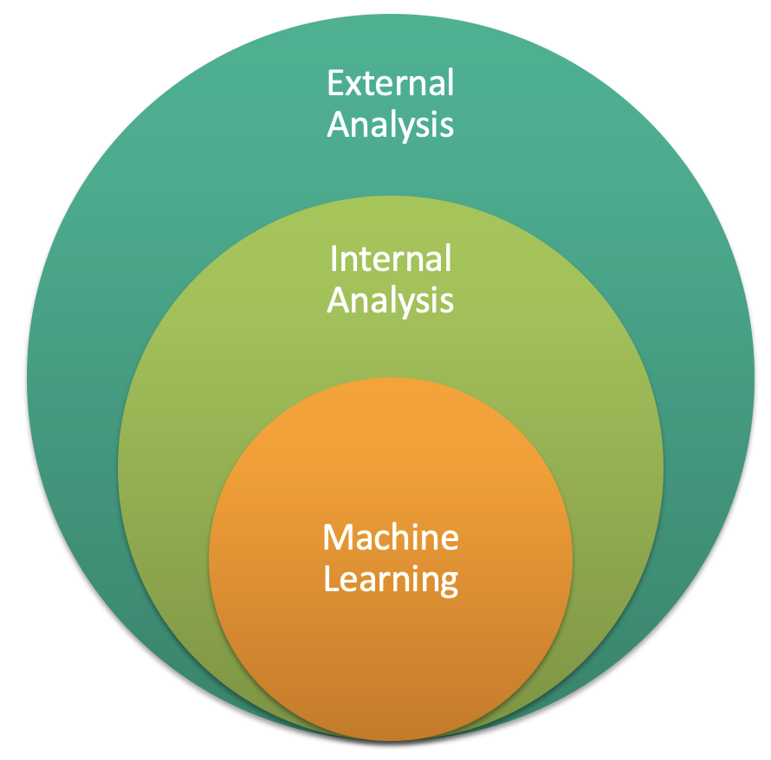
Business Analysis Strategy

Slide 6
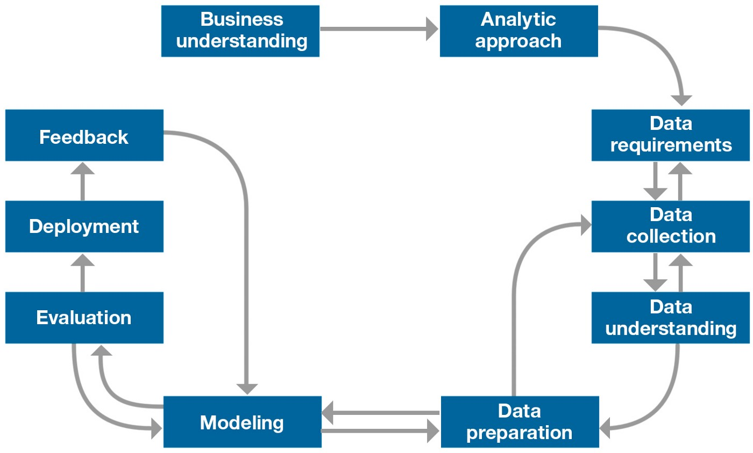
Data Science Methodology

Slide 7
Analytic Approach
Stock Price Prediction Machine Learning Tools:
Linear Regression
AutoTS Package
Facebook prophet model
Future Development:
Moving Average
Long Short Term Memory (LSTM)
k-Nearest Neighbours
ARIMA Model
Seasonality Time Series Analysis

Slide 8

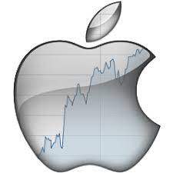
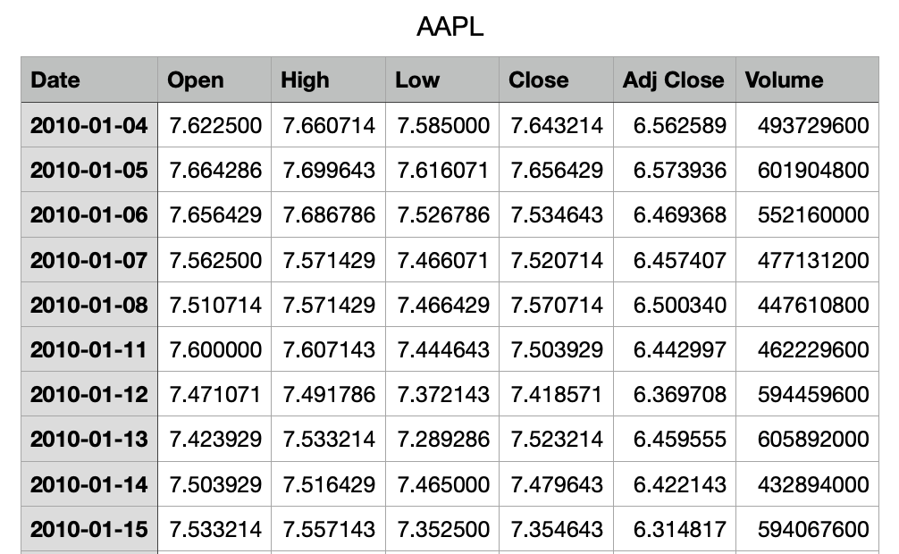
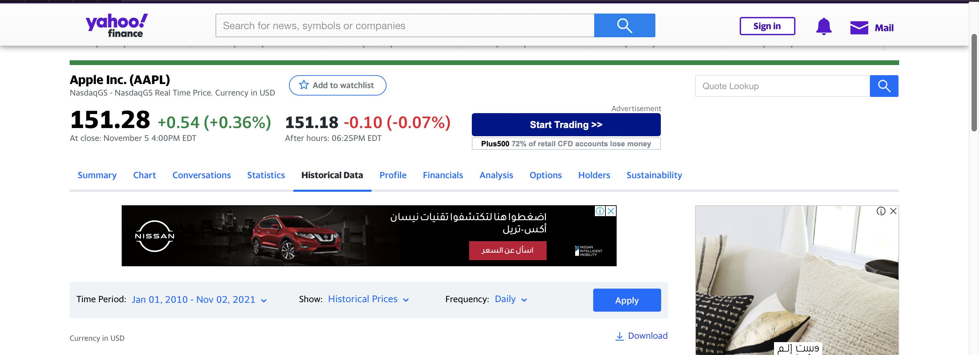
Data Requirement and Collection

Slide 9
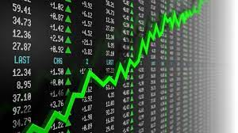
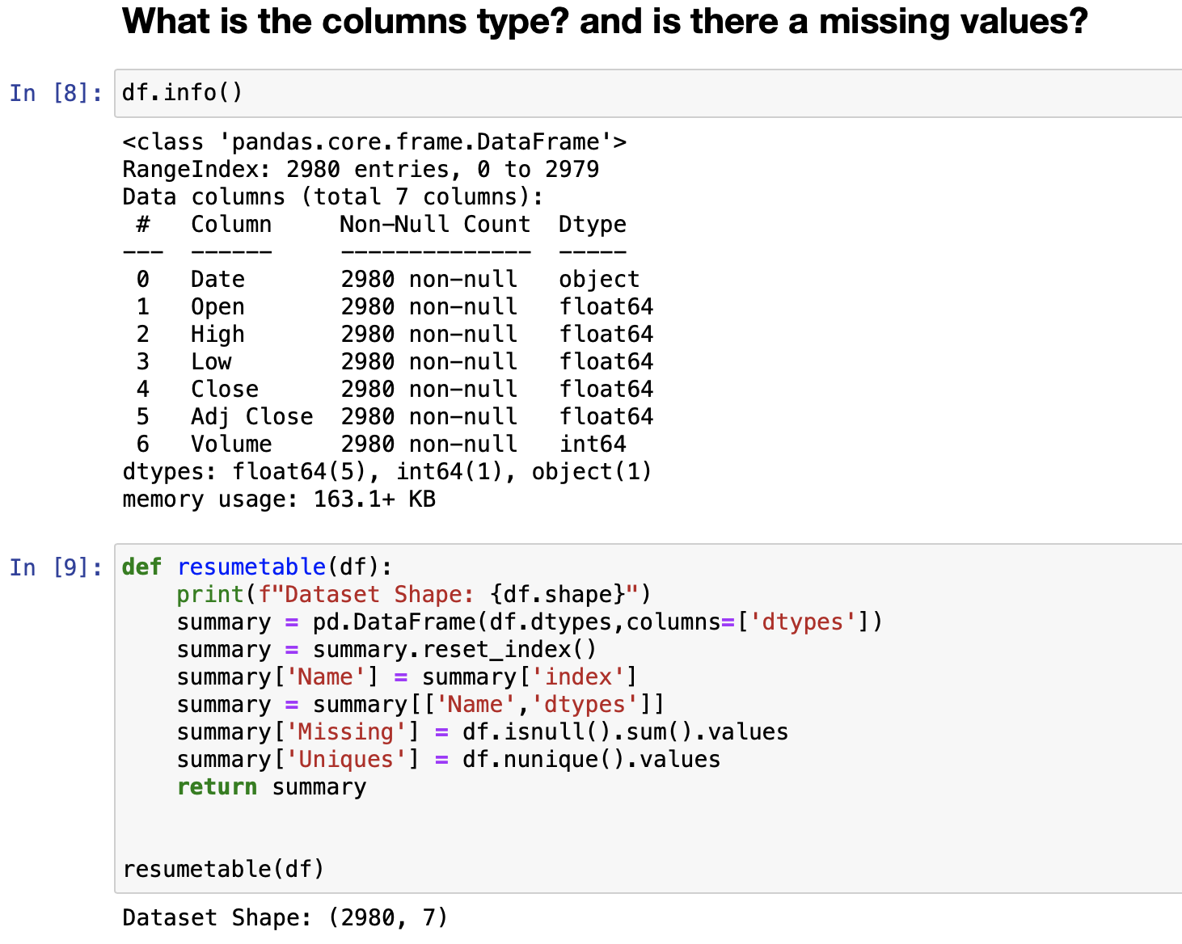
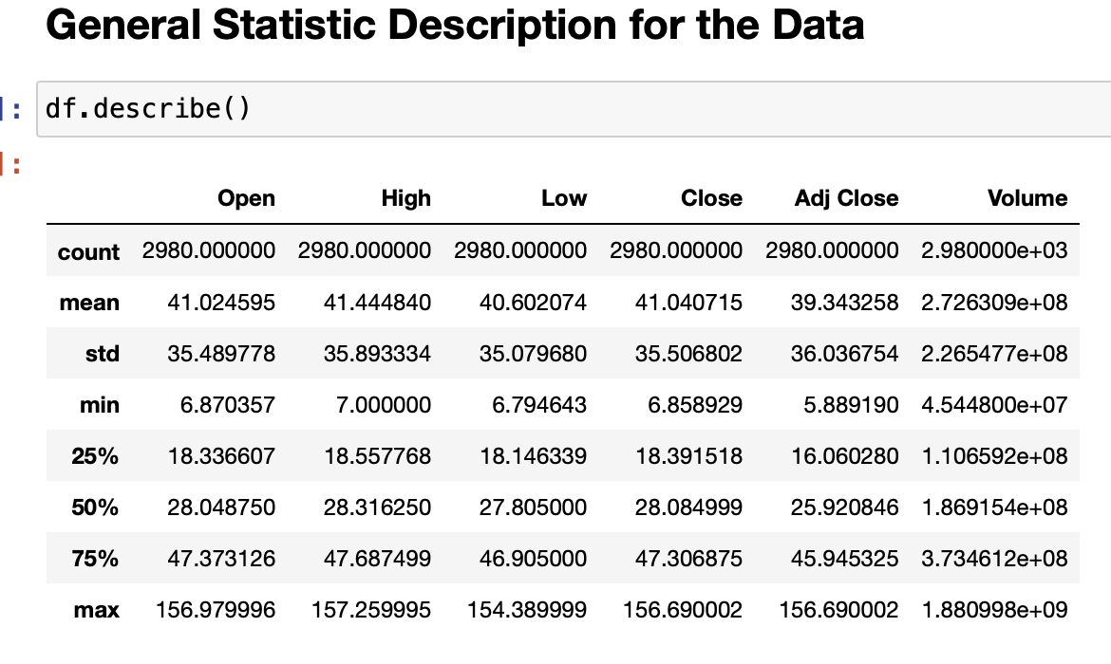
Data Understanding

Slide 10

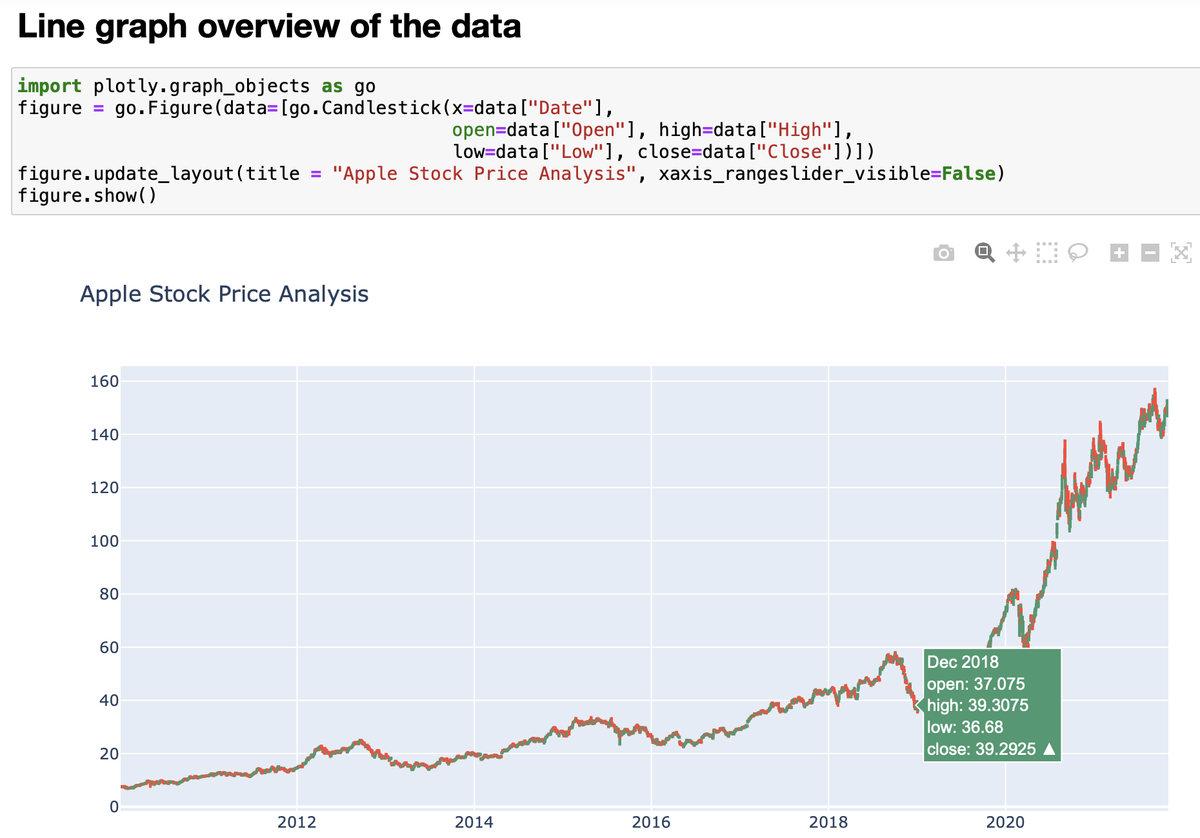
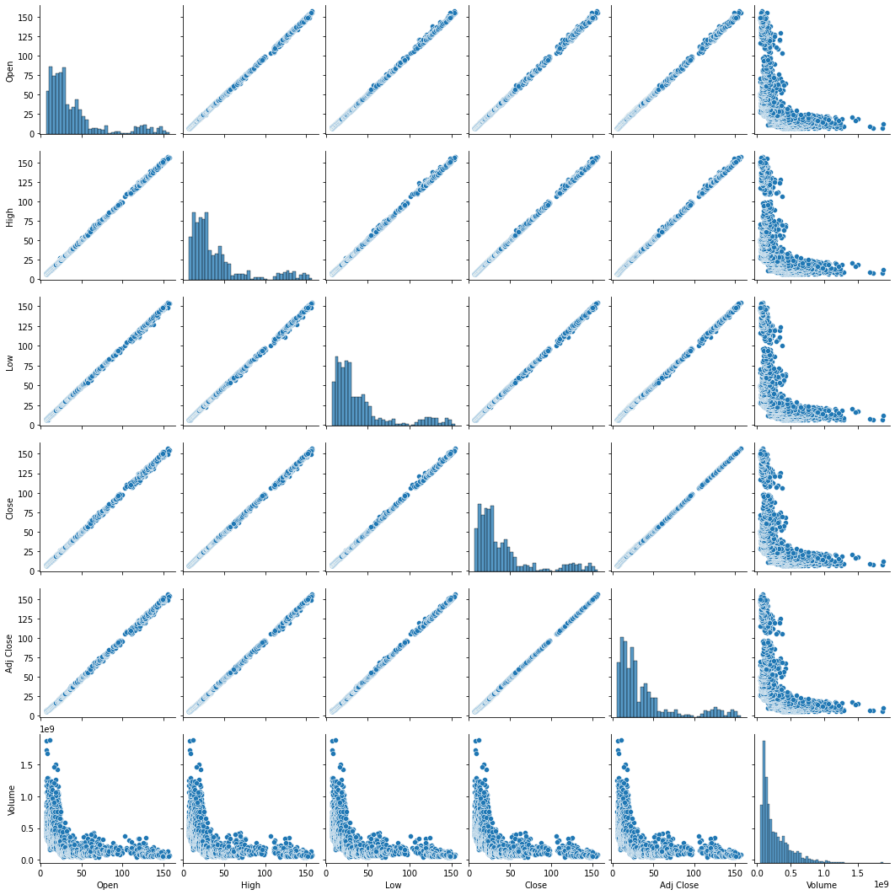
Data Preparation

Slide 11


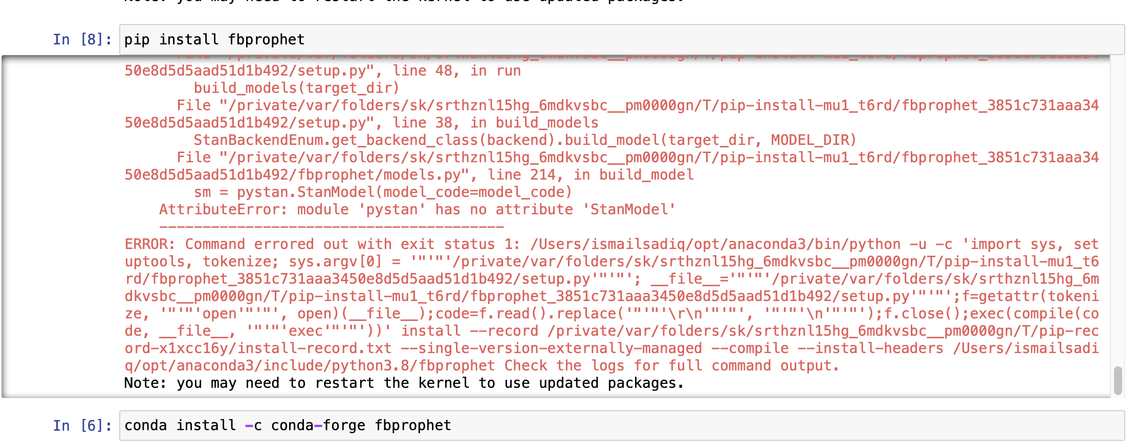
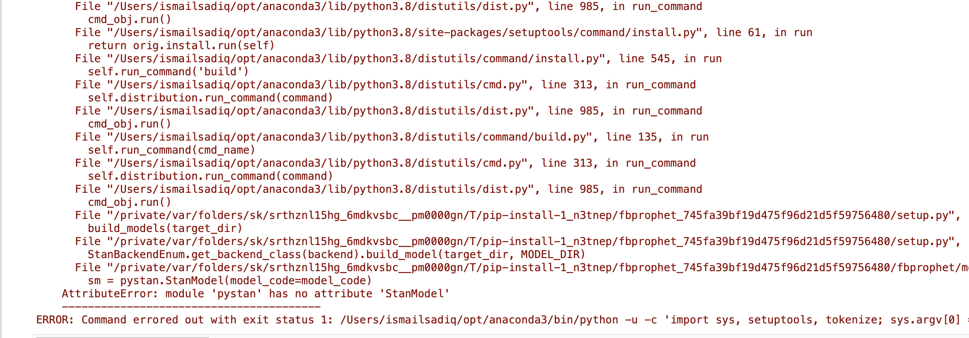
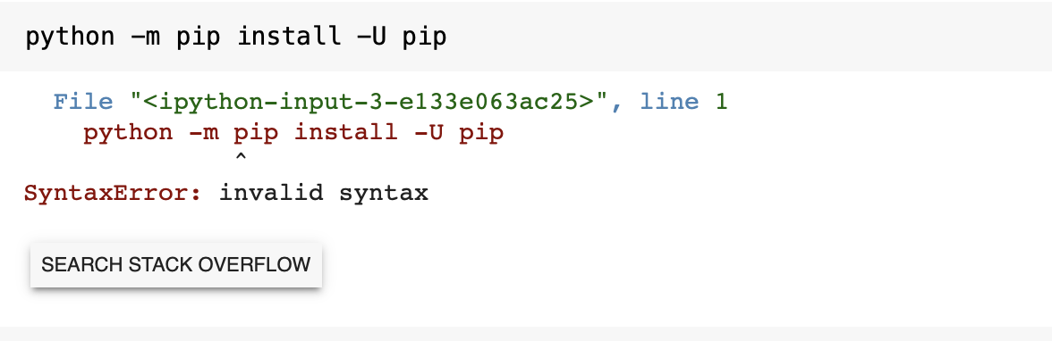
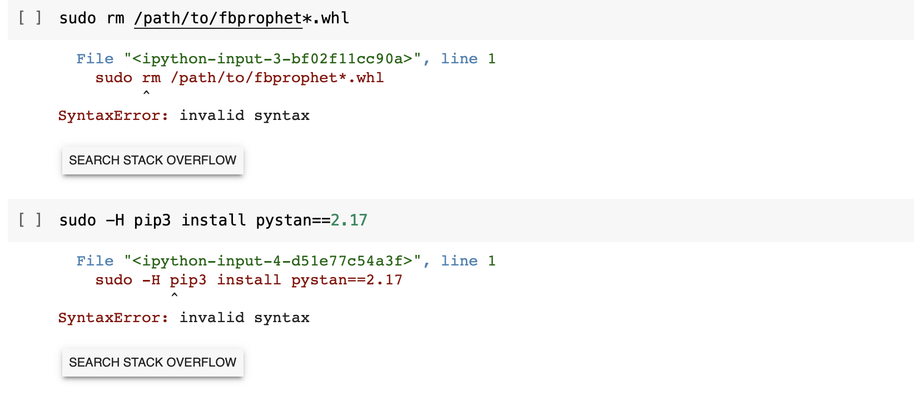
Issues & Challenges

Slide 12
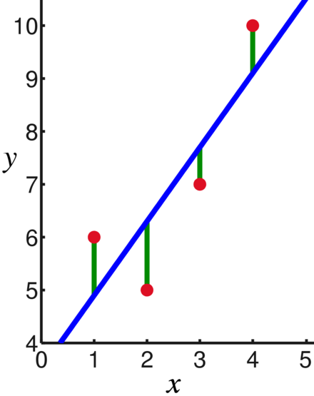
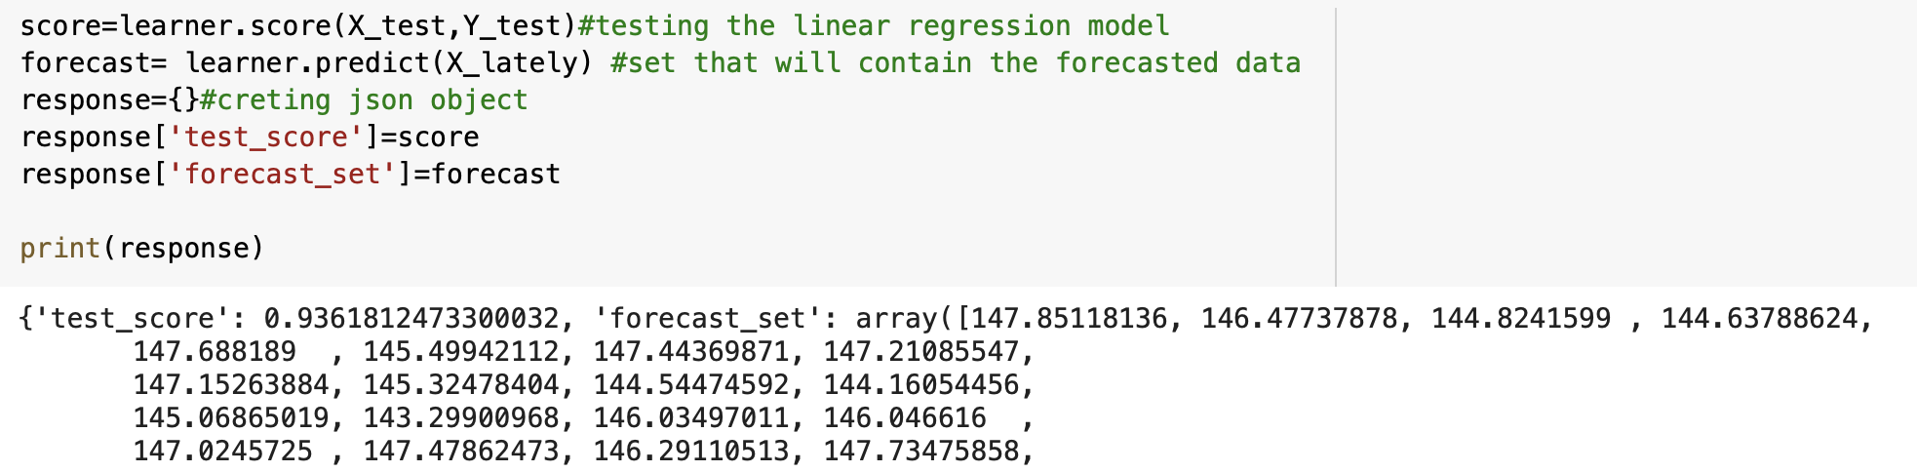
Modeling Linear Regression
Linear regression is a statistical tool used to help predict future values from past values. It is commonly used as a quantitative way to determine the underlying trend and when prices are overextended. Regression model is used to estimate the relationship between one independent variable and one dependent variable using a straight line.

Slide 13
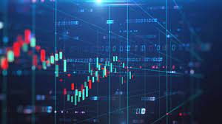
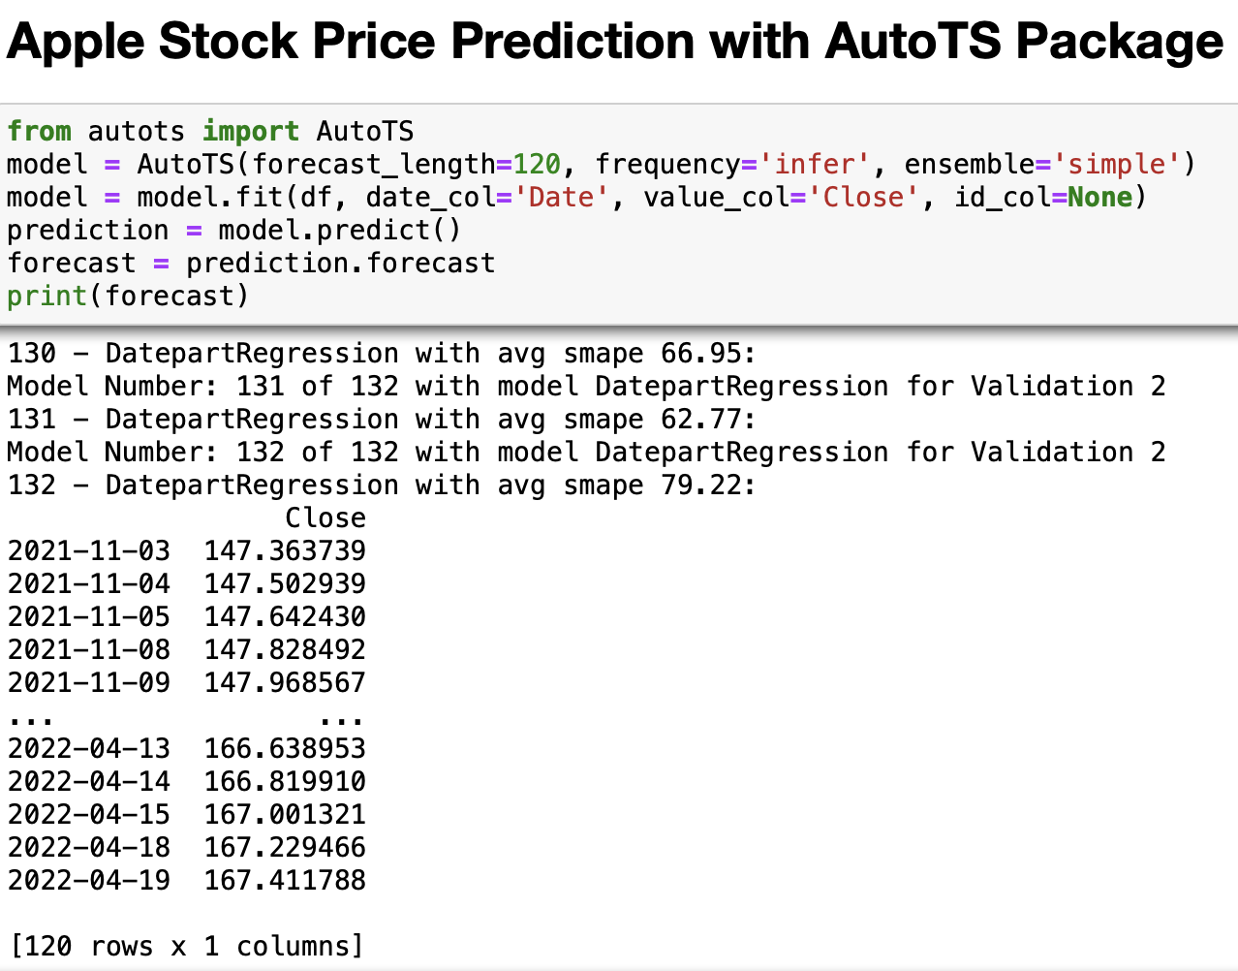
Modeling AutoTS Package
It is an open-source python library basically used to Auto-TS Forecasting. Auto-TS does the preprocessing of data, as it removes the outliers from the data and handles messy data. Using just a single line of code, Auto-TS automatically train multiple time series models such as ARIMA, SARIMAX, VAR, and produce the best performing model for our problem statement. If we try to increase the size of the dataset, the result may improve.

Slide 14
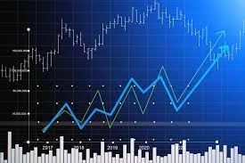
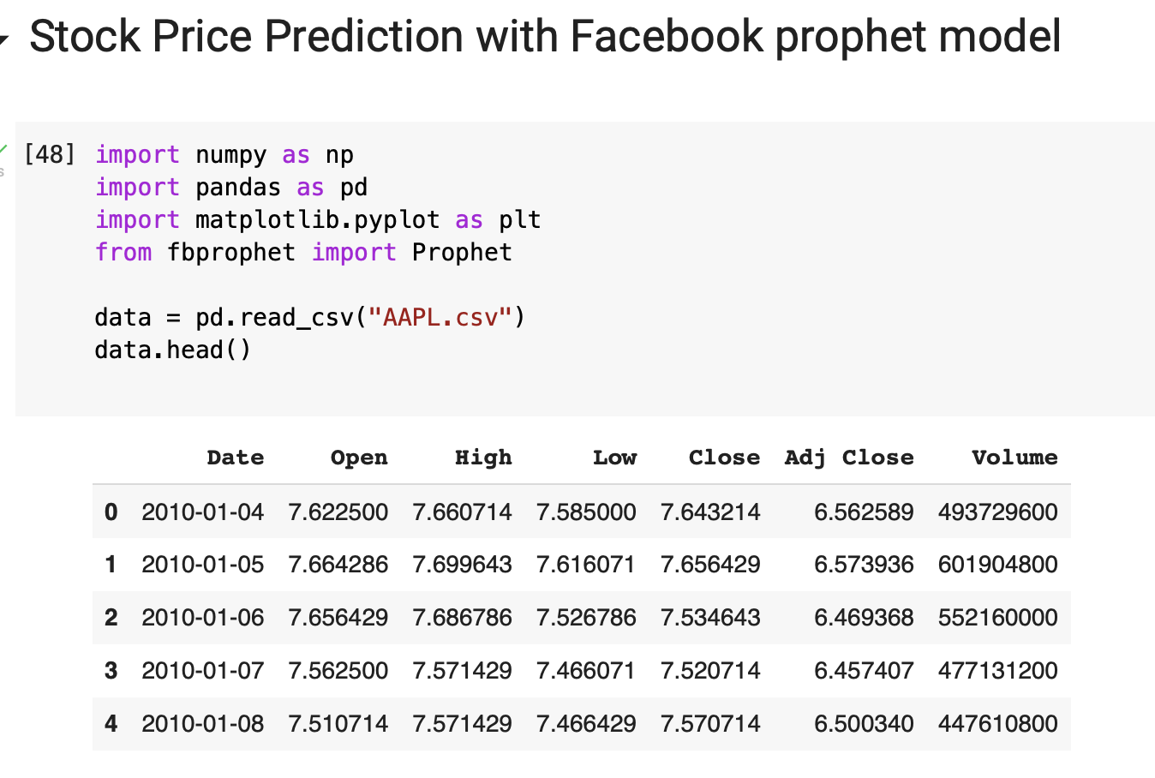
Modeling Facebook Prophet
Prophet is an open-source software released by Facebook’s Core Data Science team. Prophet is a forecasting procedure implemented in R and Python. It is fast and provides completely automated forecasts that can be tuned by hand by data scientists. Prophet requires no data preprocessing and is extremely simple to implement. The input for Prophet is a data frame with two columns: date and target (ds and y). Prophet would work well when the dataset is large

Slide 15

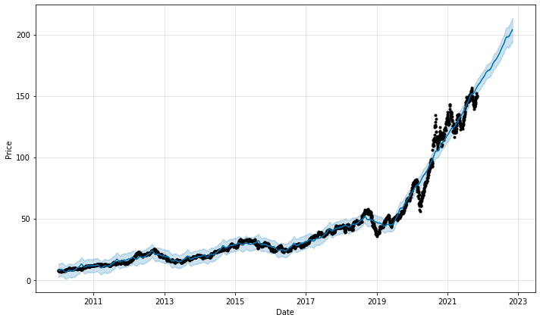
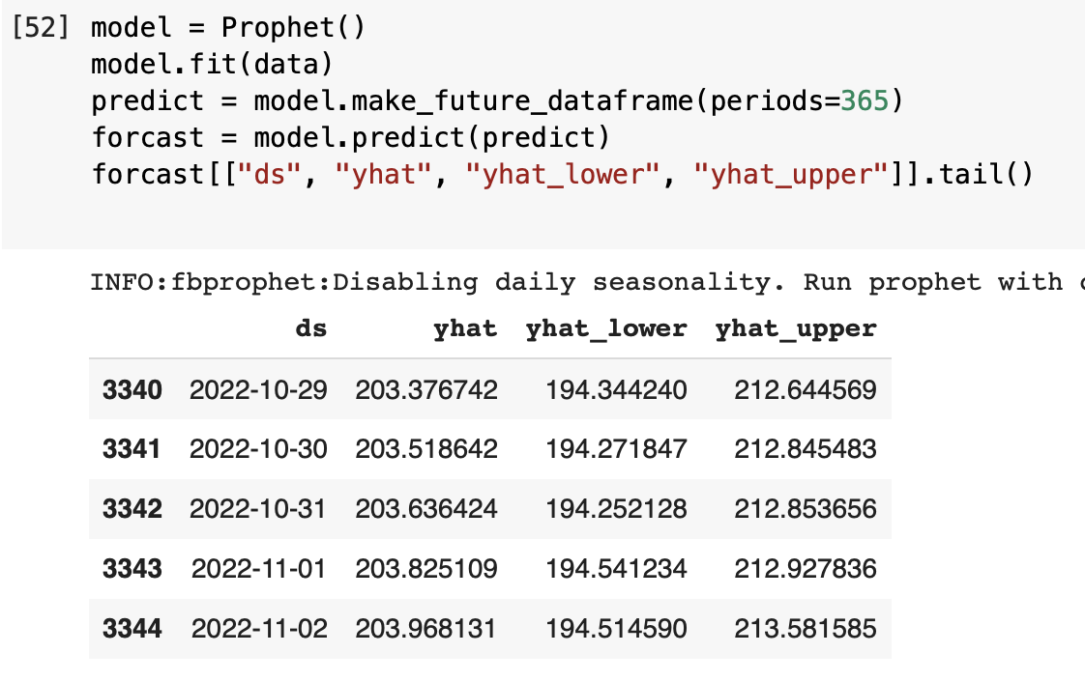
Facebook Prophet Result

Slide 16
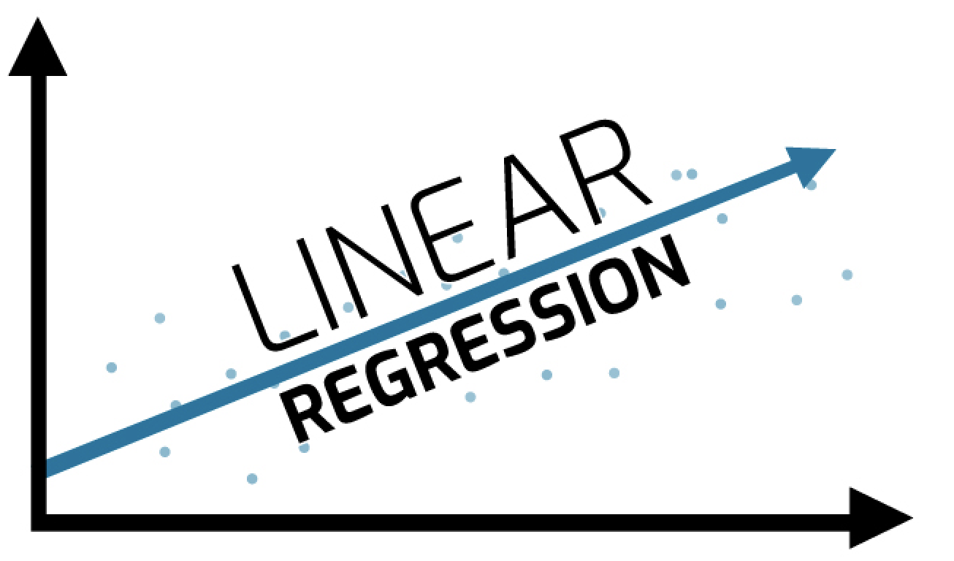


Which Model Is More Effective?

Slide 17

Conclusion
Machine Learning cannot in fact predict future performance or price with %100 accuracy. However, Machine Learning is still a tool that might give some insight to the value investors. ML Stock Prediction would be very useful if we mixed it with the external and internal Business Analysis tools.

Slide 18


GitHub Repository

Slide 19
References
Prophet. (2021). Retrieved 16 November 2021, from https://facebook.github.io/prophet/
Auto-TS | Automate Time Series Forecasting using Auto-TS. (2021). Retrieved 16 November 2021, from https://www.analyticsvidhya.com/blog/2021/04/automate-time-series-forecasting-using-auto-ts/
Stock Price Prediction Using Machine Learning | Deep Learning. (2021). Retrieved 16 November 2021, from https://www.analyticsvidhya.com/blog/2018/10/predicting-stock-price-machine-learningnd-deep-learning-techniques-python/
Time Series Forecasting using Facebook Prophet library in Python!. (2021). Retrieved 16 November 2021, from https://www.analyticsvidhya.com/blog/2020/10/time-series-forecasting-using-facebook-prophet-library-in-python/

Slide 20



Thank You
Misk Skills – DSI
Ismail Sadiq

